Slide 1

EVX-01
a personalized cancer vaccine, induces potent T-cell responses and durable disease control in advanced melanoma
Fatima aljojo.MD
Medical Oncologist

Slide 2
Outcomes of melanoma patients have improved in the last decade, but a big unmet need remains
Personalized cancer vaccines have been shown to be feasible, safe and immunogenic in clinical trials in patients with melanoma1,2
EVX-01 is a personalized peptide-based neoantigen vaccine that has shown promising early clinical activity with good safety profile1
1Mørk et al, JITC, 2024
2Weber et al, Lancet, 2024

Slide 3




Introduction
melanoma patients
Prof. Adnan Khattak
MBBS, FRACP, PhD
17th October 2025
Personalized cancer vaccines
Immunotherapy

Slide 4
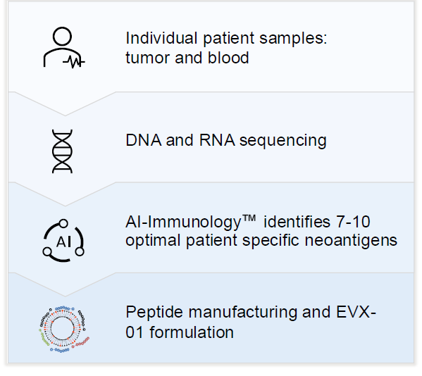
1Oncology, One Clinical Research, Hollywood Private Hospital & Edith Cowan University, Perth, WA, Australia

Slide 5
Patients & Study Design
Phase 2, n=16
Stage III/IV unresectable melanoma patients with no prior therapy
Study Endpoints: Conversion rate: SD. PR/CR or PR . CR per RECIST 1.1 ORR & Duration of response
1Oncology, One Clinical Research, Hollywood Private Hospital & Edith Cowan University, Perth, WA, Australia

Slide 6
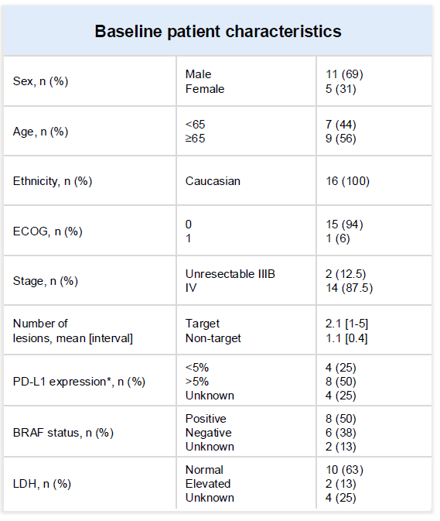
1Oncology, One Clinical Research, Hollywood Private Hospital & Edith Cowan University, Perth, WA, Australia

Slide 7
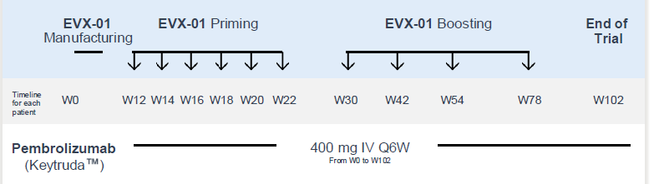
Patients & Study Design
1Oncology, One Clinical Research, Hollywood Private Hospital & Edith Cowan University, Perth, WA, Australia

Slide 8
Safety and Efficacy
EVX-01: No ≥ Grade 3 AEs attributed to EVX-01 only; 2 grade 2 AEs, and 18 grade 1 AEs
• Pembrolizumab & EVX-01 combination: 1 x G3/4 AE (pancreatitis/DKA)
• 75% Best ORR (12/16)
• 100% manufacturing success rate
1Oncology, One Clinical Research, Hollywood Private Hospital & Edith Cowan University, Perth, WA, Australia

Slide 9
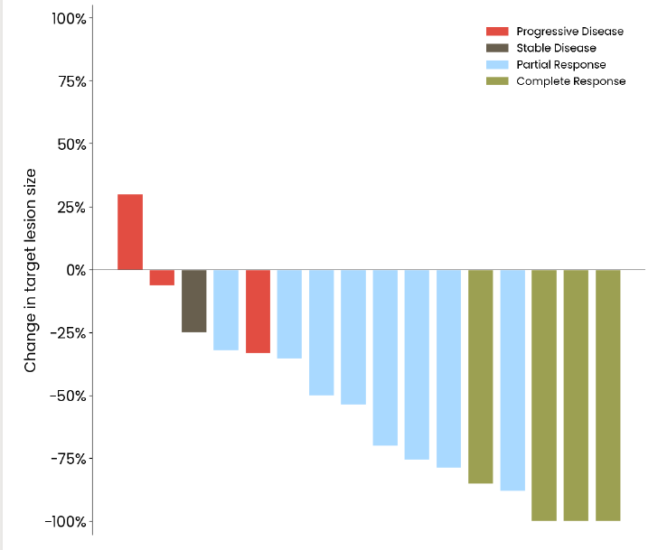
1Oncology, One Clinical Research, Hollywood Private Hospital & Edith Cowan University, Perth, WA, Australia

Slide 10
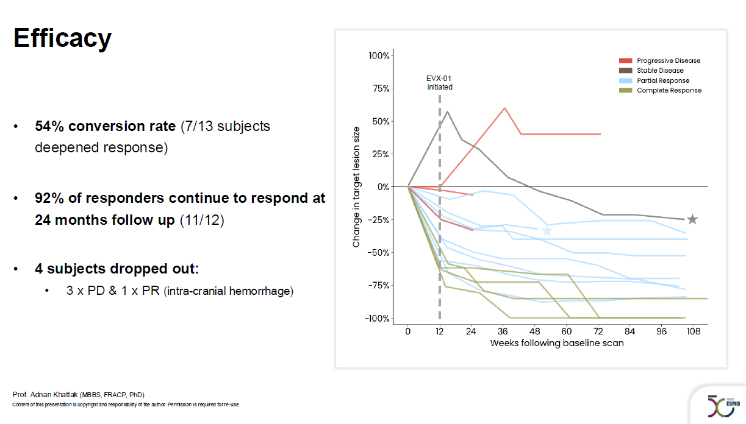

Slide 11
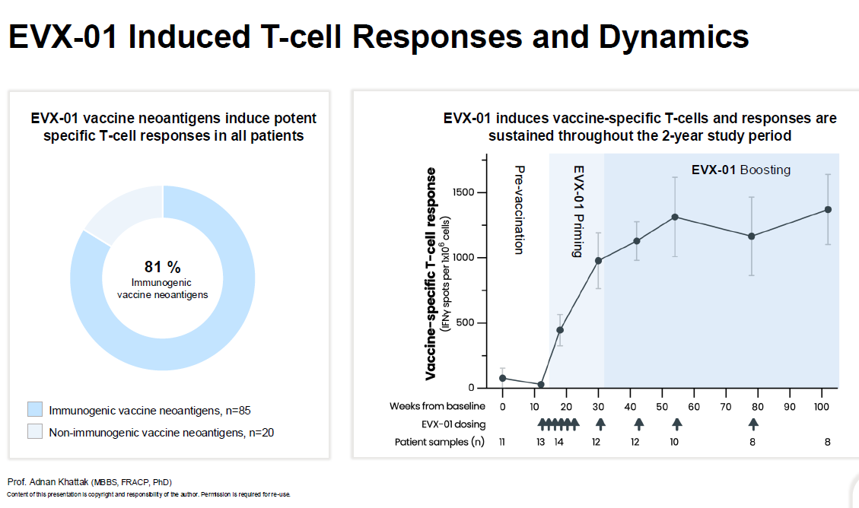

Slide 12
Conclusions
EVX-01, in combination with pembrolizumab, demonstrated: A well tolerated safety profile consistent with phase 1 data
75% ORR with 92% of responders demonstrating sustained response at 24 months
Ability to induce potent & sustained T-cell responses
Evaxion’s AI-Immunology platform successfully (81%) predicted neoantigens inducing T-cell response
1Oncology, One Clinical Research, Hollywood Private Hospital & Edith Cowan University, Perth, WA, Australia

Slide 13
Conclusions
All patients initiated EVX-01 as planned with 100% manufacturing success rate
These findings support continued development of EVX-01 in high-risk melanoma, and discussions with regulatory authorities are ongoing
1Oncology, One Clinical Research, Hollywood Private Hospital & Edith Cowan University, Perth, WA, Australia

Slide 14


